Slide 1
Tree Test Findings
onrr.gov

Slide 2
Tested categories
Getting Started | Reporting | Reporting Resources | Paying | Enforcement & Appeals | Indian Resources | About ONRR
Getting Started Home | Reporting Home | Reporting Resources Home | Paying Home | Enforcement & Appeals Home | Indian Resources Home | About ONRR Home
New Reporter Checklists | Production | Reference Lists & Codes | Rental Payments | Compliance Authorities | Cooperative Agreements | Press Releases
System Access | Royalty | Reporting Contacts | Royalty Payments | Appeals | Allottee Assistance | Leadership
 | Solid Minerals | Handbooks | Late Payment Interest | Bankruptcies | Federal Indian Minerals Office | Office Locations
 | Geothermal | Forms | Treasury Referrals | Civil Penalties | Indian Energy Service Center | Employment
 |  | Pricing |  |  | Tribal Assistance | Committees
 |  | Unbundling |  |  | Tribal Consultation | Testimony
 |  | Reporter Letters |  |  |  | Freedom of Information Act (FOIA)
 |  | Regulations |  |  |  | Anti-Harassment Program
 |  | Training Videos |  |  |  | Contact Us

Slide 3
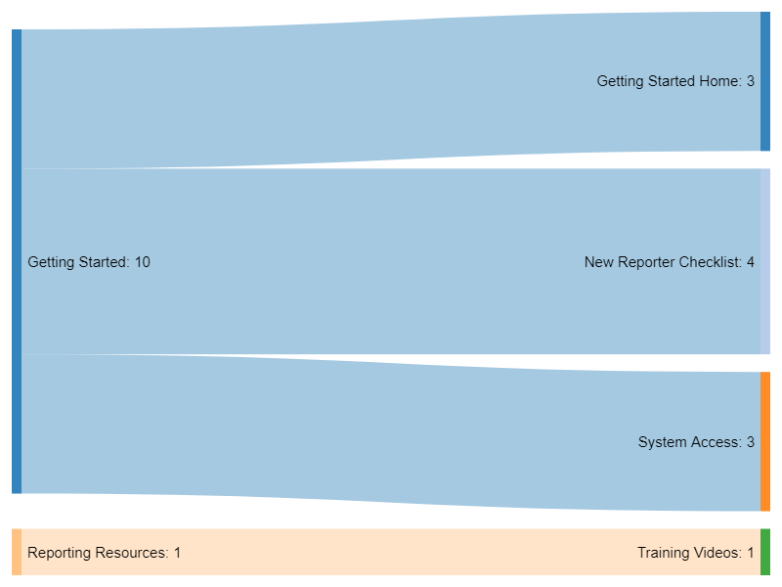
Task 1: You are a new reporter and want to get set up to start submitting reports to ONRR.
Analysis: Getting started is the right top-level category, but participants weren't sure which subcategory was right.

Slide 4
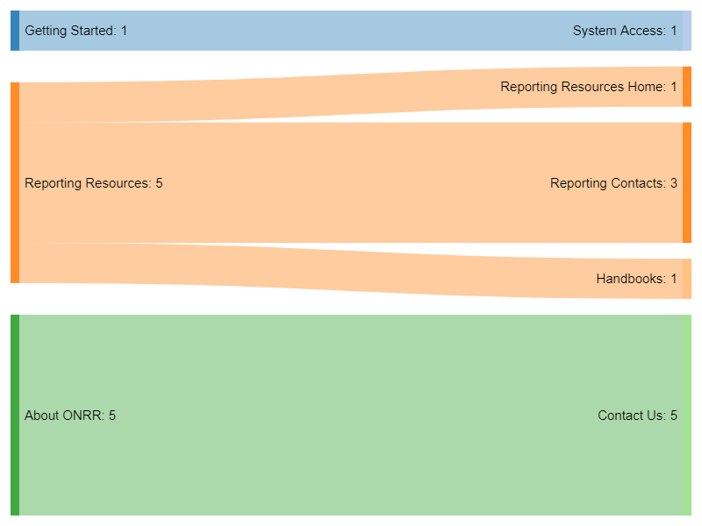
Task 2: You are having trouble logging into Data Warehouse and want to get help finding out what you should do.
Analysis: Participants had no idea where to look for this and would end up contacting.

Slide 5

Task 3: You need to report production.
Analysis: Nobody had trouble with this.

Slide 6
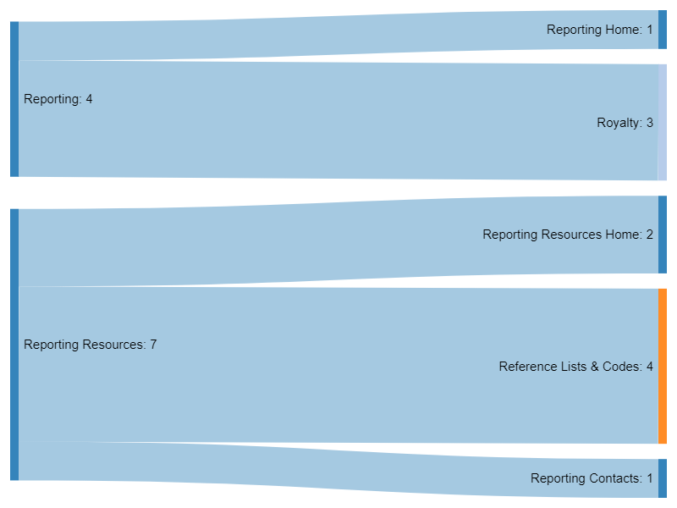
Task 4: You need to find a lease number to put on your royalty report.
Analysis: Participants weren't sure whether this was in Reporting or Reporting Resources.
Some participants would look this up in MART or eCommerce instead of onrr.gov.

Slide 7
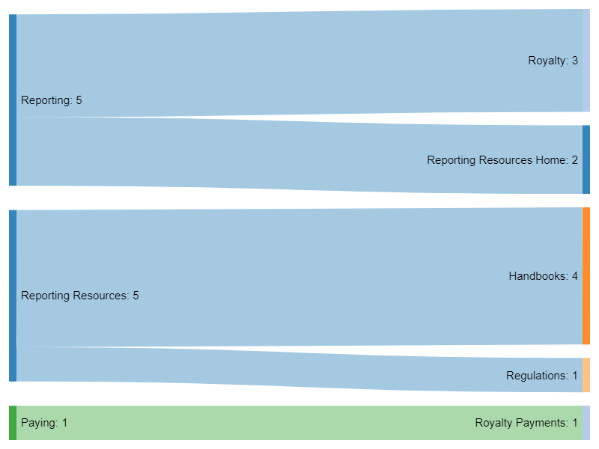
Task 5: You need to look something up in the handbook (instructions starting with P3) for oil royalty reporting.
Analysis: Split evenly between Royalty and Handbooks.

Slide 8
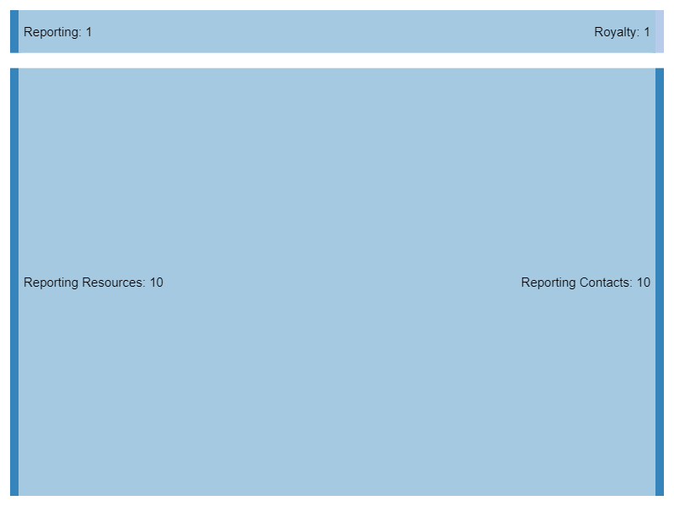
Task 6: You want to find the ONRR representative assigned to your company to contact with questions.
Analysis: Most people found contacts under resources.
Finding the correct contact has been a major pain point for many users on the current site.

Slide 9
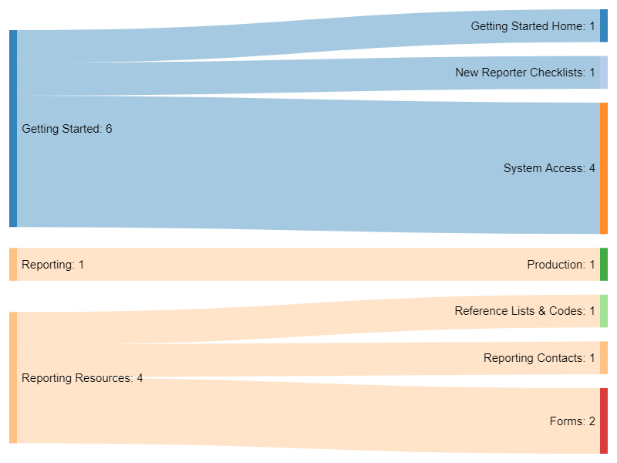
Task 7: You have a new person on your team and need to fill out the form for them to be an official contact (Addressee of Record Designation for Service of Official Correspondence Form - ONRR-4444).
Analysis: Some participants associated this with getting started and some with forms. Include it in both places.

Slide 10
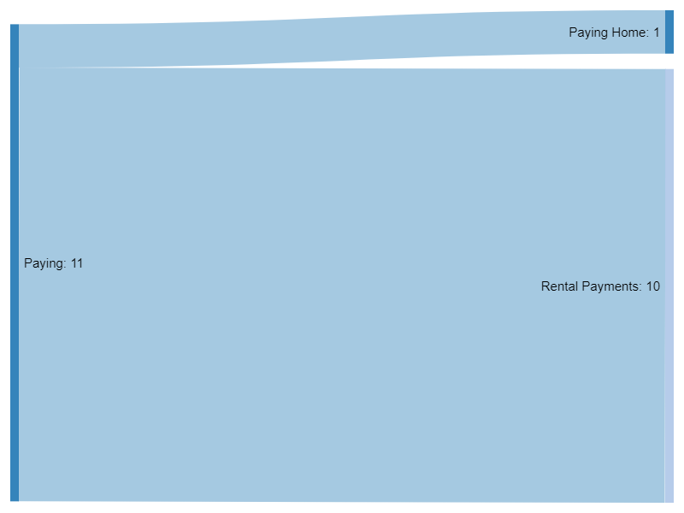
Task 8: You need to make a rent payment.
Analysis: Nobody had trouble with this.

Slide 11
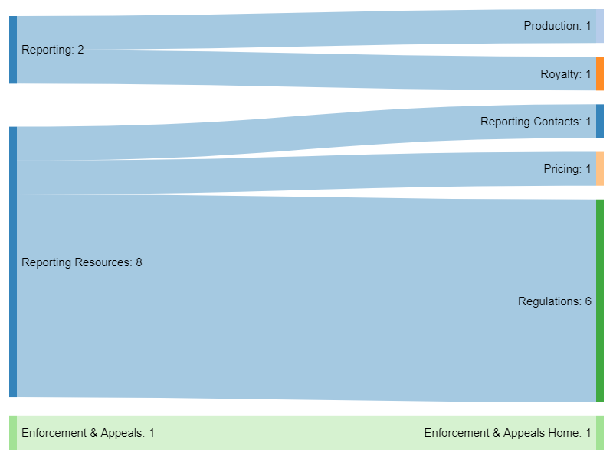
Task 9: You need to read a regulation to value a commodity on your report.
Analysis: Most people would find this under regulations, but many took a while to find that category. This was the most difficult task for participants.

Slide 12
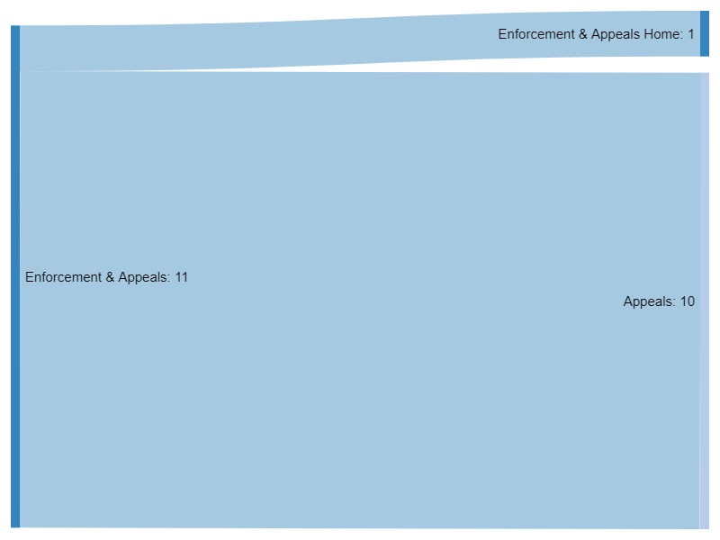
Task 10: You received an order to pay from ONRR and you would like to file an appeal.
Analysis: Nobody had trouble with this.

Slide 13
Additional findings
All participants liked the wireframe better than the current site. (11)
Participants had to think about where to look for the regulation/valuation task. (8)
Participants don't know whether to pick reporting vs. reporting resources for some tasks, particularly reference lists. (4)
Indian pricing, regulations, and codes should be cross posted in the Indian Resources category. (4)
Participants want more explanation about the process, particularly with how pricing and valuation work. (3)
Participants expected a separate category for valuation. (2)

Slide 14
Proposed structure
Getting Started | Reporting | Guidance & Regulations? | Paying | Enforcement & Appeals | Indian Resources | About ONRR
[Need new subcategories] | Production | Valuation & Pricing |  |  | [Include Indian pricing and regulations as subcategories]
 | Royalty | Regulations
 | Solid minerals | [Or maybe combine with Valuation or Enforcement?]
 | Geothermal | Reporter letters?
 | [with reporting resources as subcategories]

Slide 15
Next steps
Use the content audit to place everything into the new categories.
Revise subcategories to match to content.
Wireframe as we go to make sure we have things where we want them.
Test again after we refine the subcategories.

